Slide 1
Analysis of Elon-Centric Twitter Dataset
DBMS For Data Analytics: Final Project
Nabi Akram

Slide 2
Roadmap
Project Goals and Introduction
Questions and Analysis of Elon’s Twitter Activity
Conclusion and After thoughts
1
3
5
2
4
6
PyMongo & Twitter Dataset
Looking into SpaceX and Tesla
Any Questions?

Slide 3
Project Goals
Using PyMongo to look at Elon’s Dataset

Slide 4
PyMongo & Twitter Dataset
PyMongo
distribution tool
interact with a MongoDB database
NoSQL database
JSON type files
Elon Musk
collection of tweets
Retweets, favorites, followers, statuses, friends
SpaceX & Tesla
limited information
tweets and other useful information

Slide 5
Questions and Analysis
How often do each accounts tweet?
Is when they tweet significant?
Who interacts with their accounts the most?
Also, included are interesting tweets and other findings found throughout the data analysis process

Slide 6
What are we looking for in Elon’s tweets?
Are there any patterns to Elon’s twittering habits?
Is he manipulating the stock market?
Are Elon’s tweets representative of his twitter activity?
1
2
3

Slide 7
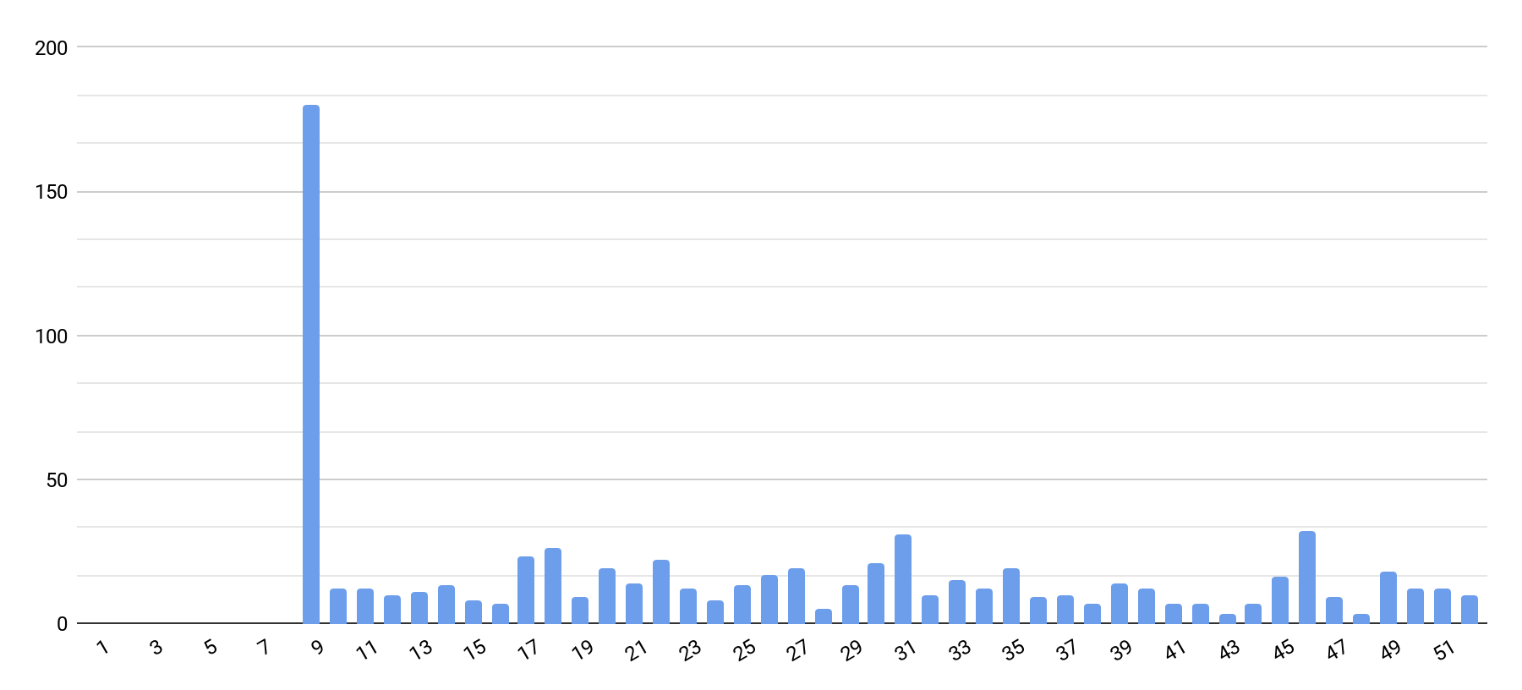
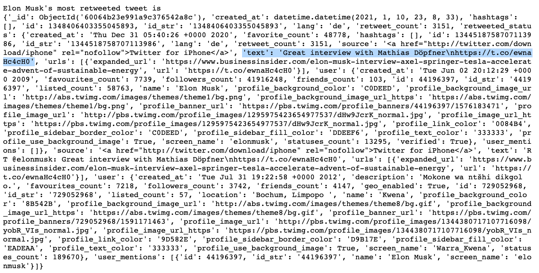
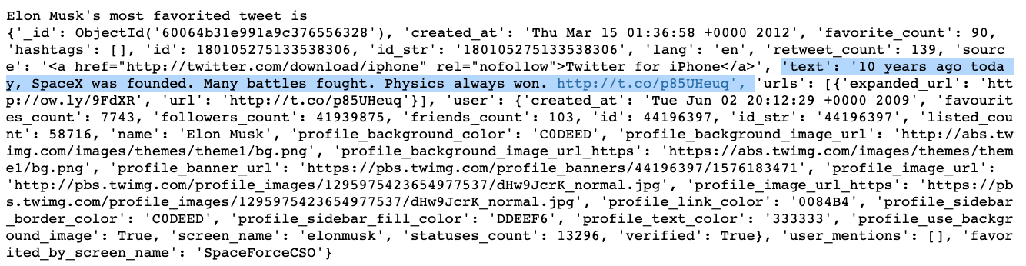
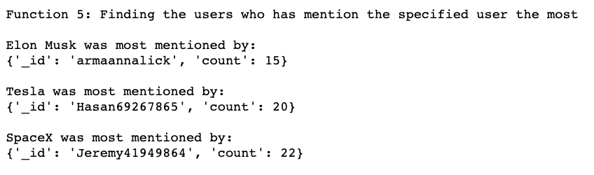
Elon Musk’s Tweets in 2020
Number of Tweets
Weeks of the Year

Slide 8
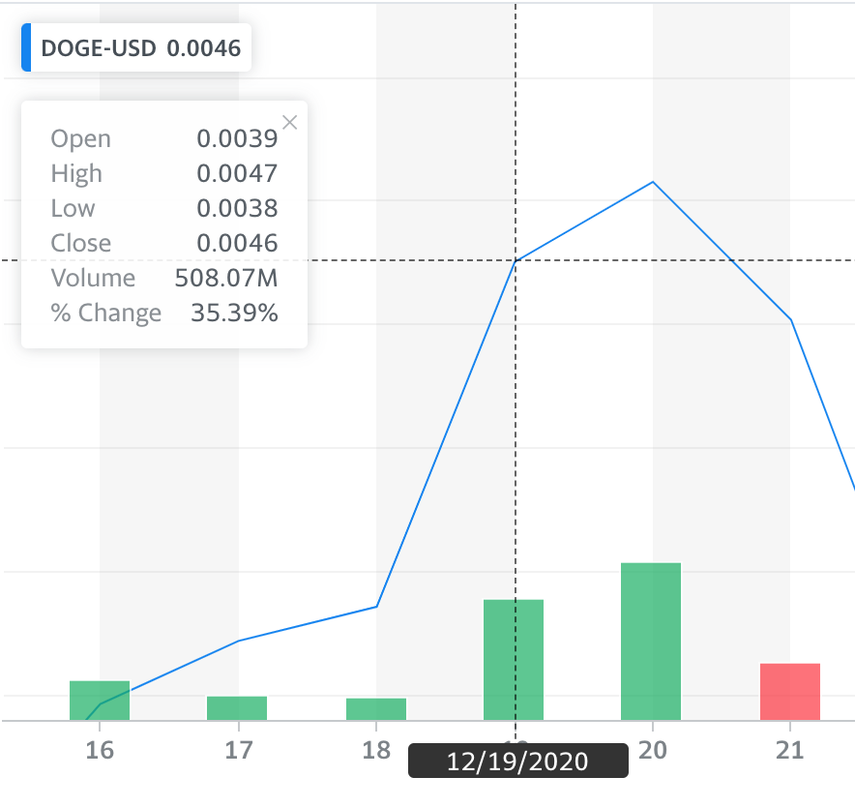
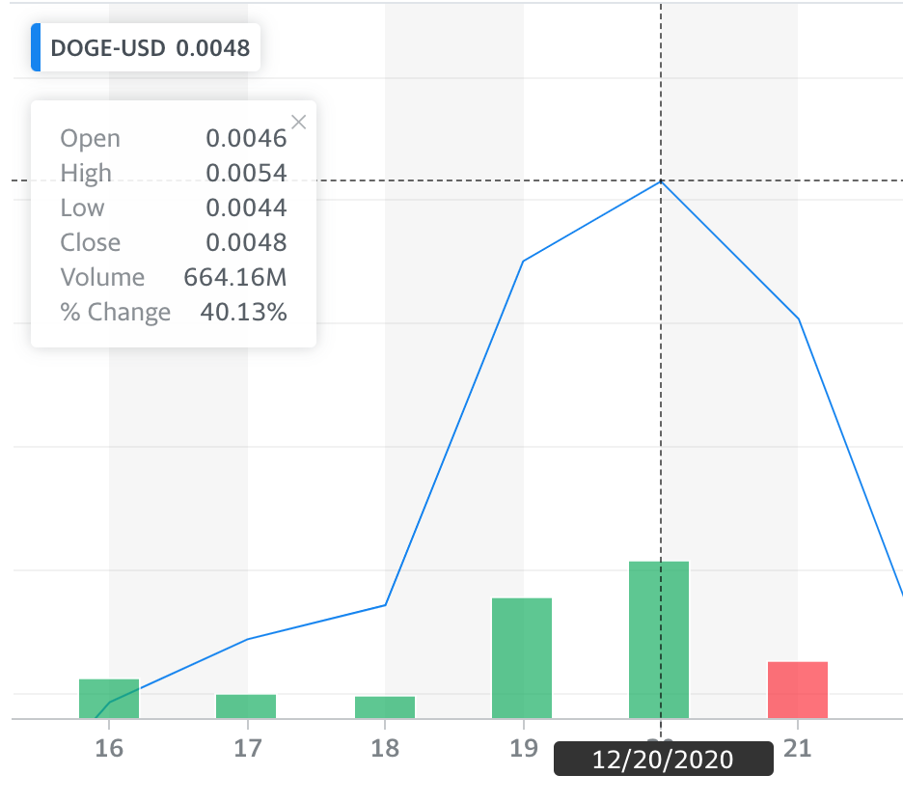
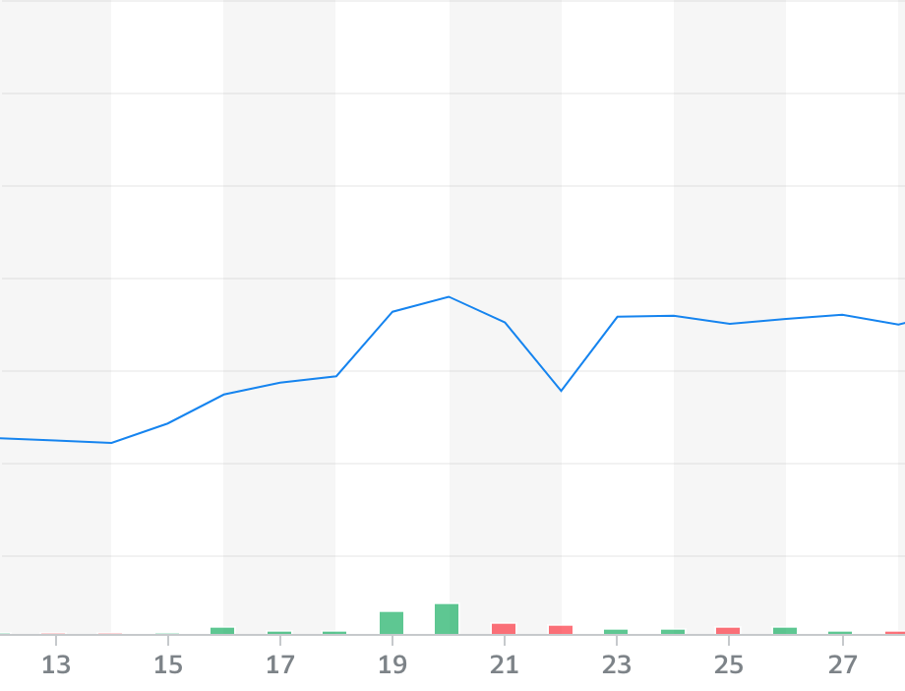

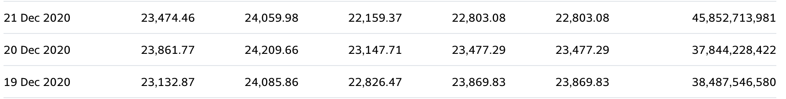
The Stock Market Controversy

Slide 9
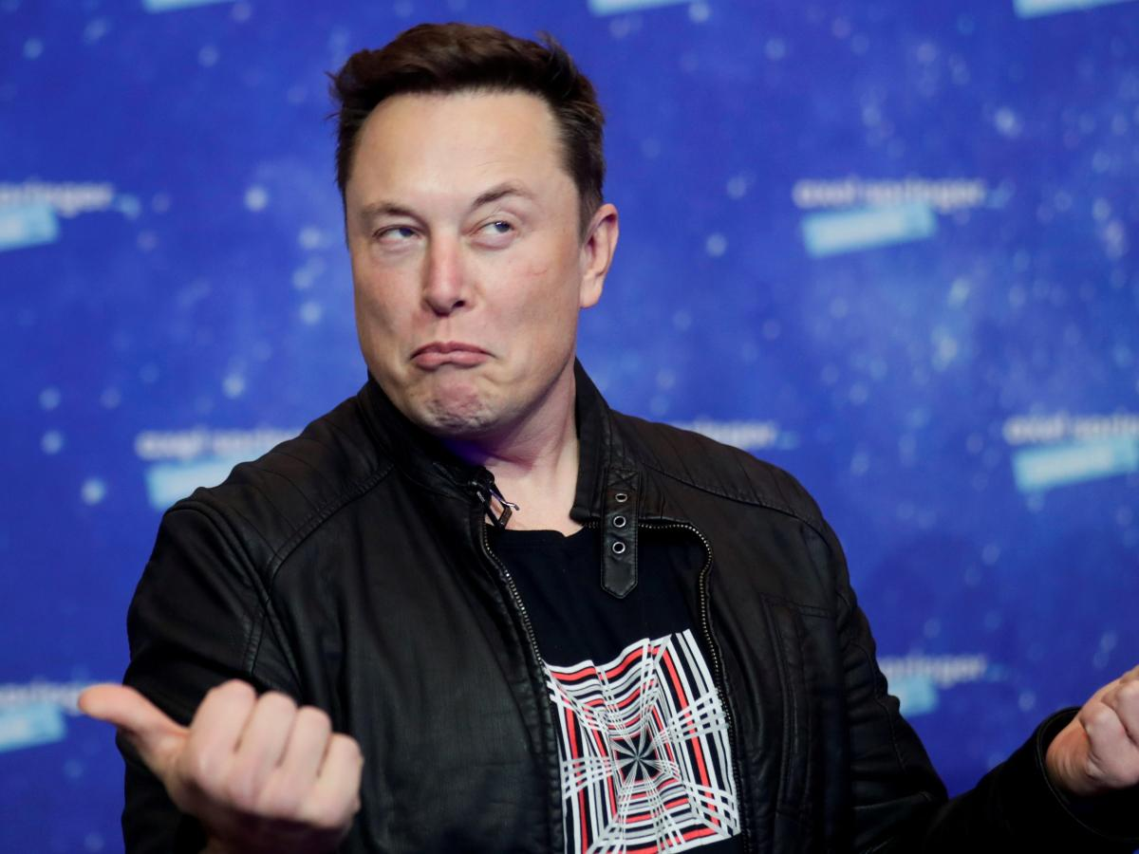
What can we say about dataset?
Well structured and contains relevant information
More insights into potential patterns in larger dataset
Twitter bios
Possible additions into dataset
Twitter replies
Complete dataset of Musk’s account
More information about other Musk related accounts

Slide 10
749 tweets
20% in volume trades
Accurate representation?
In the year 2020
After one tweet about Dogecoin
Yes, but more information would be better

Slide 11
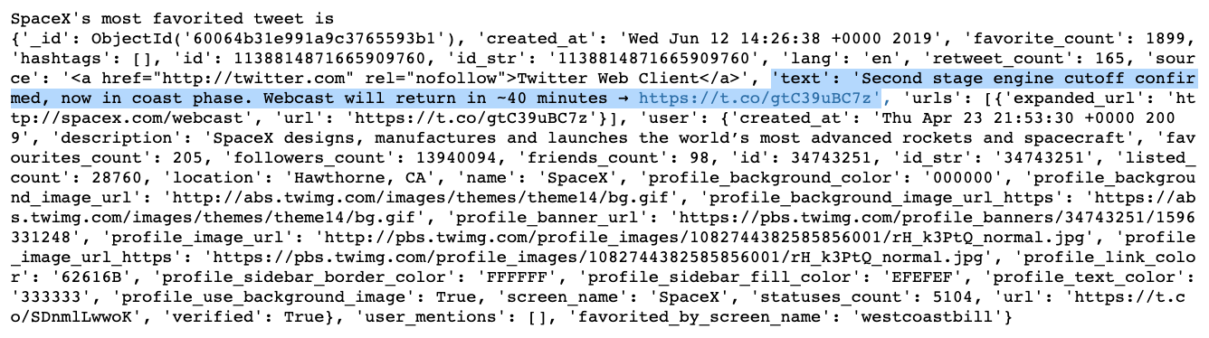
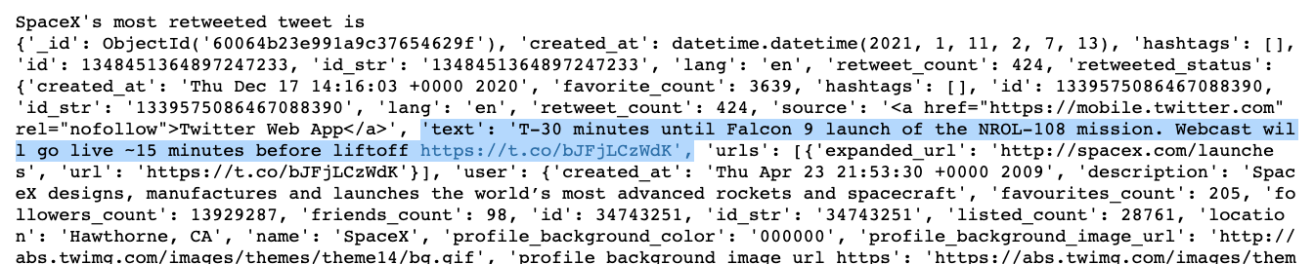

SpaceX

Slide 12
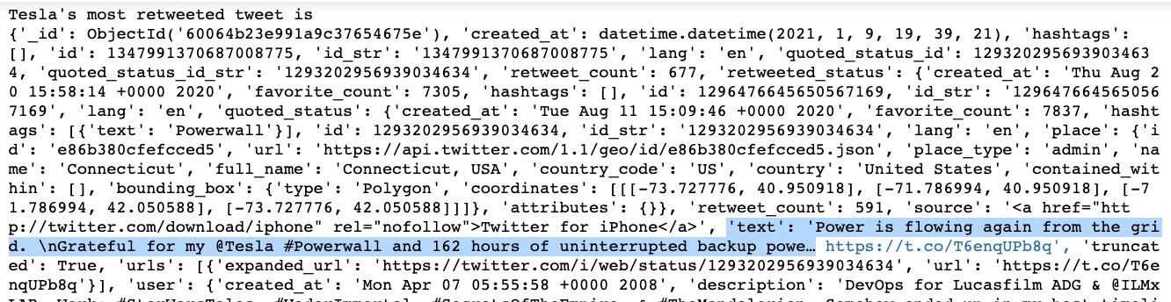
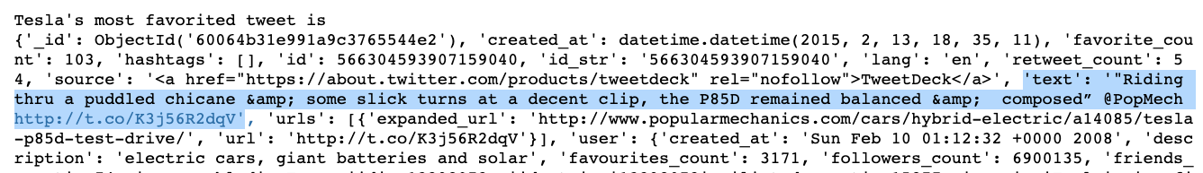
Tesla

Slide 13
Results and Conclusion
PyMongo
Thoughts: easy to use, straight forward, and provides practical analytical tools
Challenges: Making a histogram and grouping different results (most mentioned user), analyzing twitter bios
Up Next: adding more data, seeing how PyMongo would handle it, and using other analytical tools
Elon-Centric Database
Results: worked well for assignment, structure worked well (favorites, statuses, retweets, and friends)
Potential Changes to Allow More Analysis: Adding a separate field where it includes all of the replies that user’s make

Slide 14
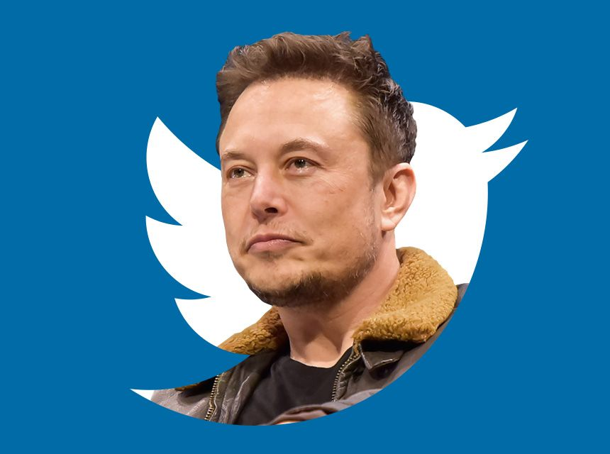
Thanks!
Any questions?

